Slide 1




Continuous Delivery the Octopus Way
Jimmy Bogard
@jbogard
github.com/jbogard
jimmybogard.lostechies.com

Slide 2


































Titanium Sponsors
Platinum Sponsors
Gold Sponsors

Slide 3
Design
Develop
Test
Release

Slide 4
Tooling
Source Control – Git
Build – psake
CI – TeamCity
Deploy - Octopus

Slide 5
Setup
Dev
Build
Version Control
NuGet Repository
Deploy
Test
Test
Promote
Package
Prod
TeamCity
Octopus Deploy

Slide 6

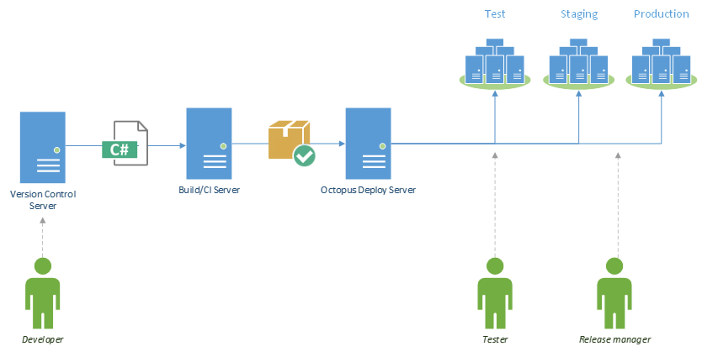


Logical Architecture

Slide 7
Demo

